Slide 1
Chapter 3: Introduction to SQL

Slide 2
Nested Subqueries
SQL provides a mechanism for the nesting of subqueries. A subquery is a select-from-where expression that is nested within another query.
The nesting can be done in the following SQL query select A₁, A₂, ..., A_{n} from r₁, r₂, ..., r_{m} where P
as follows:
From clause: r_{i} can be replaced by any valid subquery
Where clause: P can be replaced with an expression of the form:
B <operation> (subquery)
B is an attribute and <operation> to be defined later.
Select clause:
A_{i} can be replaced be a subquery that generates a single value.

Slide 3
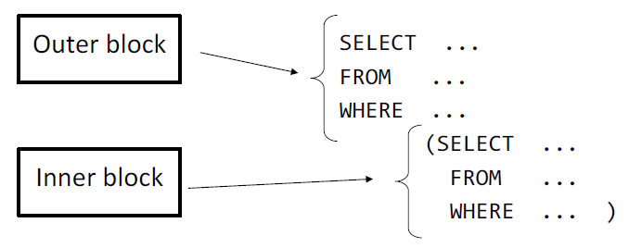
Nested Subqueries

Slide 4
Subqueries in the Select Clause

Slide 5
Scalar Subquery
Scalar subquery is one which is used where a single value is expected
List all departments along with the number of instructors in each department
select dept_name, ( select name from instructor where department.dept_name = instructor.dept_name) as instructor from department;
Runtime error if subquery returns more than one result tuple

Slide 6
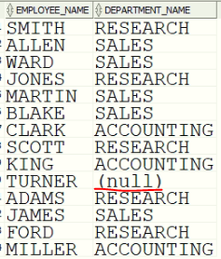
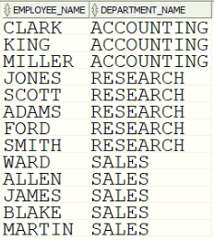
Scalar Subquery
Liste el nombre del empleado y el nombre del departamento donde trabaja. Si el empleado no trabaja en ningún departamento debe aparecer en el listado.
SELECT
e.employee_name,
d.department_name
FROM
employees e,
departments d
WHERE
e.department_id = d.department_id;
SELECT
e.employee_name,
(
select department_name from departments d
WHERE e.department_id = d.department_id
) as department_name
FROM
employees e;

